Slide 1
Edge and Corner Detection
Concept, Requirement, Types , Tools, Applications
Computer Vision, 6th Semester, 2024

Slide 2
Concept
Local features of an image:
Edges
Blobs
Corners
Edges: Boundaries of abrupt change of amplitude in pixels
Corners: Meeting points of two edges, where moving in direction depicts an abrupt amplitude change

Slide 3
Edge Detection

Slide 4
Requirement
Detection of discontinuities in the image
Highlighting of object borders and boundaries
Types of discontinuities:
Edge: set of connected pixels depicting abrupt change of intensity (pixel value)
Line: Edge present within a bounded region
Point: Line whose length and width are one pixel each
Edges act as features independent from illumination variation and preserve structural information of objects and background

Slide 5
Types of Detectors
First Derivative (gradient) operators:
Robert’s Cross gradient
Prewitt’s operator
Sobel operator
Robinson’s Compass operators
Kirsch’s Compass operators
Second Derivative operators:
Laplacian
Laplacian-of-Gaussian (LoG)
Frei-Chen operator

Slide 6
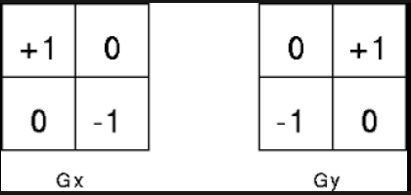
Robert’s Cross Gradient Operator
2x2 mask
Awkward to use
Centre pixel of image generally overlaps on top left corner of mask
Usage:
Low-resource realtime environments
Educational setup
Pre-processing
Feature extraction

Slide 7
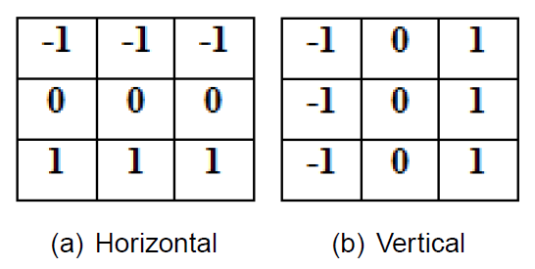
Prewitt’s Operator
Better than 2x2 operator (centre pixel of mask corresponds to centre pixel in the overlapped region)
Used to detect edges in horizontal and vertical directions
Simple, efficient edge detection

Slide 8
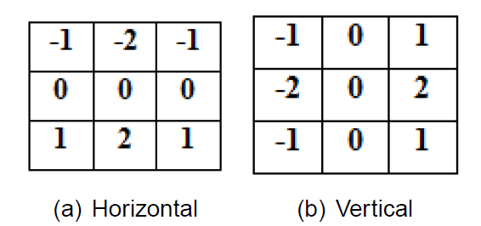
Sobel Operator
Weighted Prewitt’s operator
Highlights the detected edges
Usage:
Effective edge detection
Noise filtering
Gradient computation
Gradient-based filtering
Feature extraction
Image segmentation

Slide 9
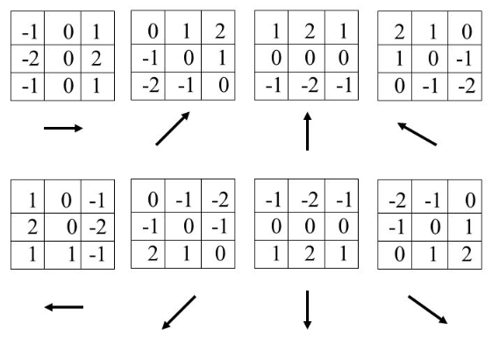
Robinson’s Compass Operators
Edge detection in compass directions
8 directional masks used
May vary with weights but overall sum in each mask is zero
Utility:
Multiple directional sensitivity
Rotational invariance
Effective pre-processing
Useful in pattern recognition

Slide 10
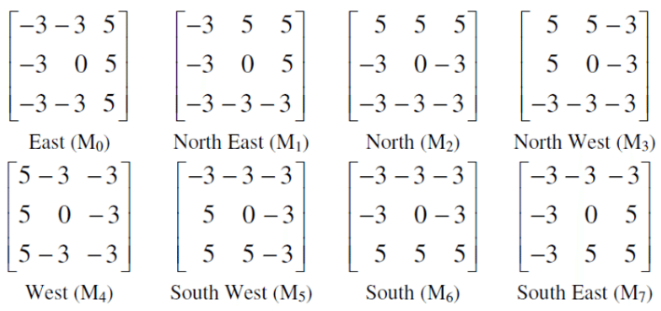
Kirsch Operators
Weighted Compass operator
Highlights the detected edges
Utility – similar to that of Robinson masks, plus:
Orientation detection
Shape analysis

Slide 11
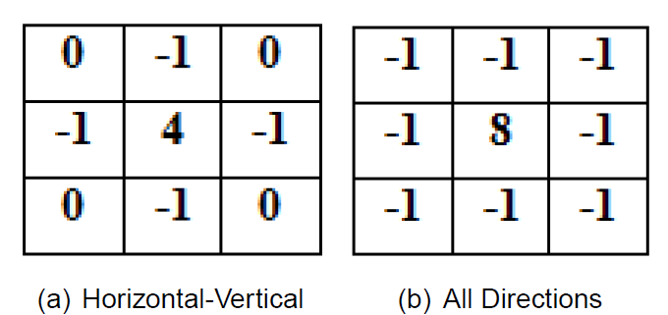
Laplacian operator
Second derivative operator
Resembles high-pass filters
Utility:
Edge Detection
Zero-Crossing Detection (locations where the intensity changes sign, indicating the presence of an edge)
Fine Detail Enhancement
Edge Sharpening
Blob Detection (regions with significant intensity changes)
Multiscale Analysis (detection of edges at various levels/scales of detail)
Texture Analysis
Feature Extraction

Slide 12
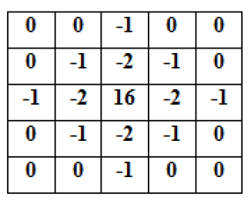
Laplacian of Gaussian (L-o-G)
Gaussian smoothing applied prior to Laplacian mask
Gaussian mask applied first, to smoothen the image
Laplacian derivative filter applied next to highlight the detected edges
Utility – similar to Laplacian, plus:
Edge Localization
Noise Reduction
Blob and Feature Detection
Scale-Space Representation
Corner Detection
Image Enhancement

Slide 13
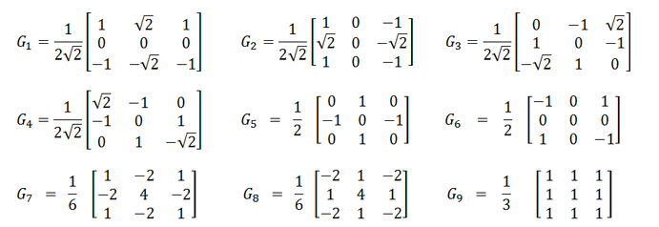
Frei-Chen Masks
Set of nine masks to detect edges, lines, and average value
G1 to G4 – edge detectors
G5 to G8 – line detectors
G9 – average value computation
Utility:
Isotropic Edge Detection (edge detection responses that are consistent in all directions)
Feature extraction, texture analysis, and pattern recognition
Orientation detection, zero-crossing detection, and scale-space analysis

Slide 14
Canny edge detection
Smoothing (Gaussian Blur):
Smooth the image using a Gaussian filter.
Reduce noise and prepare the image for subsequent edge detection.
Convolution with a Gaussian kernel has a blurring effect and suppresses high-frequency noise.
Gradient Calculation:
Find the image gradient to identify the intensity changes and edges using derivatives (usually Sobel operators) in both the horizontal and vertical directions.
Non-Maximum Suppression:
Thin the edges and keep only the local maxima in the gradient direction.
Compare each pixel's gradient magnitude with its neighbors along the gradient direction and suppress non-maximum values.
Edge Tracking by Hysteresis:
Edge pixels are classified into strong, weak, or non-edges based on gradient magnitude thresholds.
Pixels with gradient magnitudes above a high threshold are considered strong edges, while those below a low threshold are considered non-edges. Weak edges fall between the two thresholds.
To form continuous edges, weak edges are connected to strong edges by virtue of pixel connectivity. If a weak edge pixel is connected to a strong edge pixel, it is considered part of the edge.
Identify edges in images while reducing the impact of noise and providing a well-defined and connected edge map
Utility:
Accurate Edge Detection
Noise Reduction
Edge Localization
Minimal Response to Noise
Gradient-Based Detection
Automatic Thresholding
Edge Connectivity
Versatility in Applications
Feature Extraction
Scale-Space Analysis

Slide 15
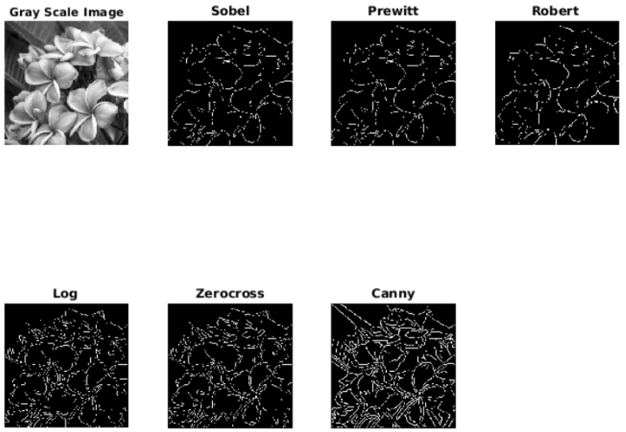
Example of edge detection

Slide 16
Corner Detection

Slide 17
techniques
Moravec Detector
Harris Detector
FAST – Features from Accelerated Segmentation Test
Min-Eigen – Minimum Eigenvalue algorithm
BRISK – Binary Robust Invariant Scalable Keypoints
ORB – Oriented FAST and Rotated BRIEF (Binary Robust Independent Elementary Features)

Slide 18
Moravec Detector
Works by:
considering a local window in the image
determining the average changes of image intensity that result from shifting the window by a small amount in various directions
Checks similarity scores of considered pixel neighborhood with neighboring patches [most used: sum of squared differences (SSD)]
Cases considered:
Windowed image patch is flat (i.e. approximately constant in intensity)
All shifts will result in only a small change
Window straddles an edge
A shift along the edge will result in a small change
A shift perpendicular to the edge will result in a large change
Windowed patch is a corner or isolated point
All shifts will result in a large change
A corner can thus be detected by finding when the minimum change produced by any of the shifts is large (low self-similarity or high SSD)

Slide 19
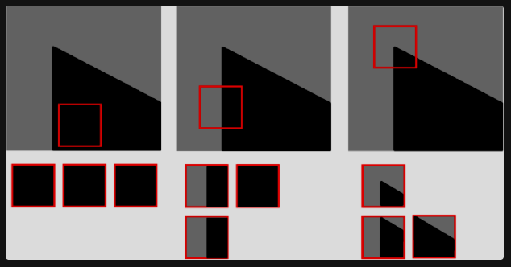
Moravec Detection logic

Slide 20
Moravec Corner Detector
Usefulness:
Enhance corner features
Non-maximal suppression
Thresholding applied
Issues:
Multiple responses at high interest points
Extend non-maximal suppression to windows
Weak response to “blurred” corners
Slow
Not isotopic
If an edge is present that is not in the direction of the neighbours, then the smallest SSD will be large and the edge will be incorrectly chosen as an interest point.

Slide 21
Harris Detector
Finds locations in an image where there are significant variations in intensity in two orthogonal directions (corners)
Key concept – analyzing the changes in pixel intensities when the image is shifted in a small neighborhood
Evaluate the response of a local window to shifts in different directions and calculate a corner response function
Corner – pixel exhibiting high value of this response function.

Slide 22
Harris Detector Algorithm
Take the grayscale of the original image
Apply a Gaussian filter to smooth out any noise
Apply Sobel operator to find the x and y gradient values for every pixel in the grayscale image
For each pixel p in the grayscale image, consider a 3×3 window around it and compute the corner strength function. Call this its Harris value.
Find all pixels that exceed a certain threshold and are the local maxima within a certain window (to prevent redundant dupes of features)
For each pixel that meets the criteria in 5, compute a feature descriptor.

Slide 23
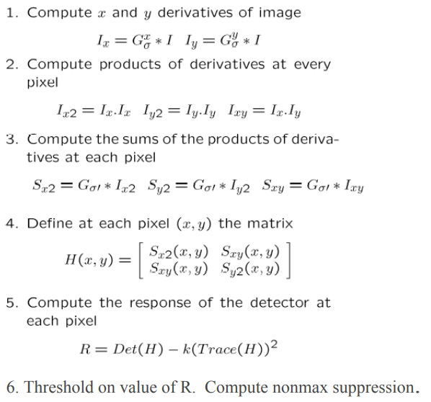

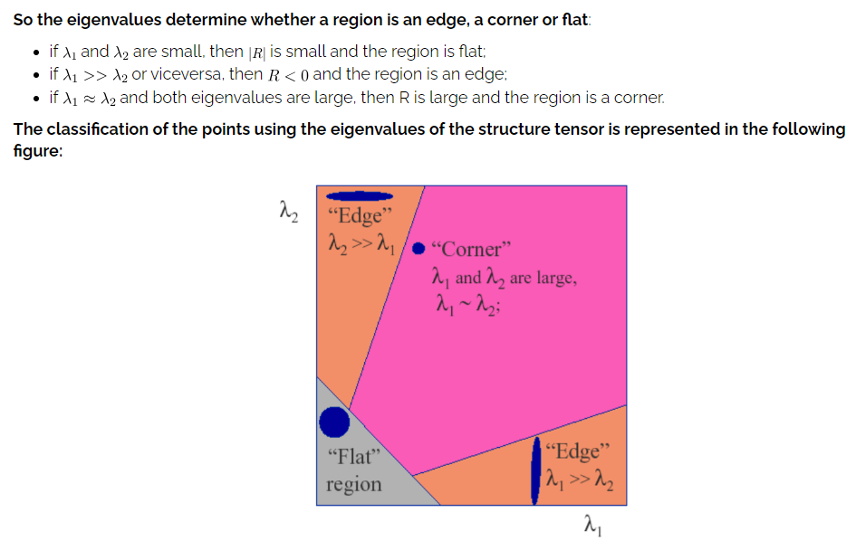
Harris Corner Detection

Slide 24
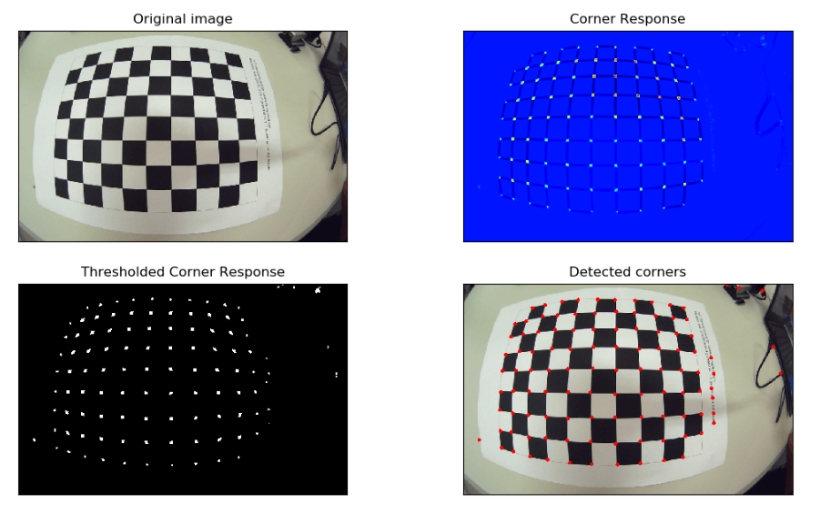
Harris Corner Detection – Example

Slide 25
F.A.S.T. Detection
FAST – Features from Accelerated Segmentation Test
Concepts:
Corner Criterion:
Compare the intensity of a pixel with the intensities of its surrounding pixels in a circular pattern.
A pixel = a corner if there is a set of contiguous n pixels (a contiguous arc) in the circular pattern s.t. the intensity of the central pixel is significantly different from the intensities in this arc/set.
Contiguous Arc:
The contiguous arc consists of 16 equally spaced pixels on a circle with a radius of 3 pixels.
Intensity Comparison:
A pixel is considered part of the contiguous arc if its intensity is either significantly higher or significantly lower than the intensity of the central pixel.
Thresholding:
If at least n contiguous pixels have intensities significantly higher or lower than the central pixel, the central pixel is marked as a corner candidate.
Non-Maximum Suppression:
Only the corner candidates with the highest intensity variations are retained.
Rotation Invariance:
To achieve rotation invariance, FAST uses a circular pattern of pixels. This ensures that the corner detection is not sensitive to the orientation of features.
Efficiency:
The algorithm reduces the number of intensity comparisons by employing a decision tree structure that quickly determines whether a pixel is a corner candidate.

Slide 26
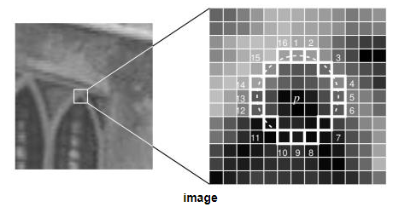
F.A.S.T. Detection algorithm
Select a pixel P in the image. Assume the intensity of this pixel to be IP. This is the pixel which is to be identified as an interest point or not.
Set a threshold intensity value T, (say 20% of the pixel under test).
Consider a circle of 16 pixels surrounding the pixel p. (This is a Bresenham circle [4] of radius 3.)
“N” contiguous pixels out of the 16 need to be either above IP + T or below IP – T, if the pixel needs to be detected as an interest point. (First proposed value of N = 12)
To make the algorithm fast, first compare the intensity of pixels 1, 5, 9 and 13 of the circle with IP. At least three of these four pixels should satisfy the threshold criterion so that the interest point will exist.
If at least three of the four pixel values – I1, I5, I9, I13 – are not above IP + T or below IP – T, then P is not an interest point (corner). In this case reject the pixel p as a candidate. Else if at least three of the pixels satisfy the condition, then check for all 16 pixels and check if 12 contiguous pixels fall in the criterion.
Repeat the procedure for all the pixels in the image.

Slide 27
F.A.S.T. Detection – merits and demerits
Merits
Demerits
Real-Time Performance
Simple Concept
Rotation Invariance
Low Computational Complexity
Few Parameters
Sensitivity to Noise
Limited to Corners
Fixed Thresholding
Non-Maximum Suppression Limitations
Limited to Single Scale

Slide 28
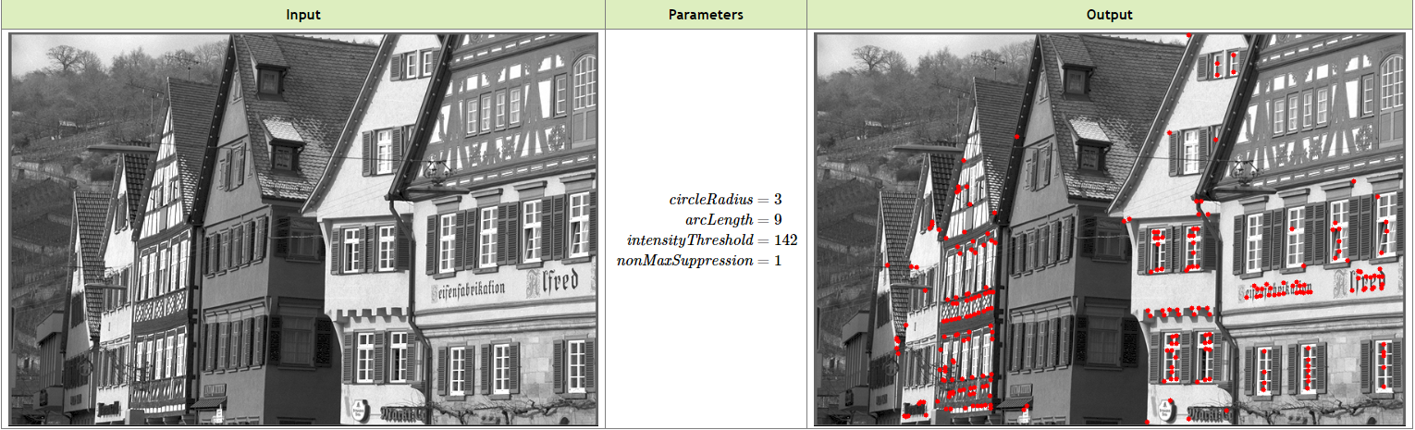
F.A.S.T. Detection

Slide 29
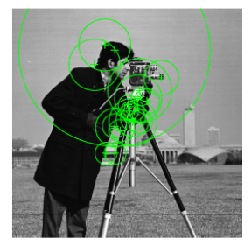
B.R.I.S.K. Detection
BRISK – Binary Robust Invariant Scalable Keypoints
Designed to be efficient, robust to changes in scale and viewpoint, and invariant to rotation
Uses FAST detection at its basis
Concepts:
Binary Descriptors
Scale-Invariant Detection
Rotation-Invariant Detection
Detection and Orientation Assignment
Descriptor Generation
Brisk Pattern
Pattern Selection and Matching
Scalability

Slide 30
B.R.I.S.K. Detector Concepts
Binary Descriptors
Scale-Invariant Detection
Rotation-Invariant Detection
BRISK utilizes binary descriptors for keypoints generated based on a pattern of intensity comparisons in the local neighborhood of a keypoint.
BRISK is designed to be scale-invariant by constructing a scale pyramid and detecting keypoints at multiple scales.
BRISK is also designed to be rotation-invariant by using a circular sampling pattern during the generation of binary descriptors, repeated at different scales.
Detection and Orientation Assignment
Descriptor Generation
Brisk Pattern
A fast strategy is used that involves sampling points in a circular pattern and comparing the responses to those of a smoothed image.
The algorithm assigns an orientation to each detected keypoint based on the analysis of the circular pattern.
The binary descriptor for each keypoint is generated by comparing the intensities of pixels in the keypoint neighborhood.
The binary pattern is defined based on the sign of the intensity differences, resulting in a compact and efficient representation.
The intensity comparisons in the local neighborhood are performed using a rotation-invariant sampling pattern called the BRISK pattern

Slide 31
B.R.I.S.K. Detector Concepts
Pattern Selection and Matching
Scalability
The algorithm dynamically selects sampling patterns based on the image content, improving its robustness.
Matching of binary descriptors is typically performed using methods like Hamming distance.
The algorithm can efficiently process images at different resolutions and still produce reliable keypoints and descriptors.

Slide 32
B.R.I.S.K. Detection Algorithm
Scale Space Construction
Keypoint Detection using FAST
Orientation Assignment by circular pattern analysis
Adaptive Sampling Pattern Selection based on local image content
Binary Descriptor Generation by pixel pair comparison
Descriptor Matching
Non-Maximum Suppression
Thresholding to filter out low-response keypoints
Localization (optional) by sub-pixel refinement model

Slide 33
B.R.I.S.K. Detection – Merits and Demerits
Merits
Demerits
Efficiency
Scale and Rotation Invariance
Binary Descriptors
Adaptive Pattern Selection
Multi-Scale Approach
Real-Time Performance
Limited to Corners
Sensitivity to Noise
Fixed Thresholding
Fixed Descriptor Length
Complexity in Adaptive Features

Slide 34
O.R.B. Detection
O.R.B. – Oriented FAST and Rotated BRIEF (Binary Robust Independent Elementary Features)
Detects corners using a combination of the FAST corner detector and a Harris corner response
Key aspects:
Efficient keypoint detection
Rotation invariance
Binary descriptors

Slide 35
O.R.B. Corner Detection Algorithm
Image Pyramids:
Construct a pyramid of images at different scales (octaves) to detect keypoints at multiple resolutions.
Each level of the pyramid is obtained by smoothing the original image with a Gaussian filter.
Fast Keypoint Detection:
Apply the FAST corner detector at each level of the image pyramid.
Harris Corner Response:
Calculate the Harris corner response for each candidate keypoint.
The Harris response is computed using the eigenvalues of the gradient matrix at the keypoint.
Keypoint Selection:
Select keypoints based on a combination of the FAST response and the Harris response.
The combination helps ensure that the selected keypoints exhibit both corner-like structures and a strong Harris corner response, providing distinctive and robust keypoints.
Orientation Assignment:
Assign an orientation to each selected keypoint, by analyzing the intensity distribution around the keypoint, to make the descriptors rotation-invariant.
Subpixel Localization:
Refine the locations of the keypoints for improved accuracy, by fitting a model to the intensity values in the local neighborhood of each keypoint, providing more precise location estimates.
Keypoint Filtering:
Apply additional filtering criteria, such as removing keypoints with low response values or those close to image borders, to ensure the selection of high-quality keypoints.

Slide 36
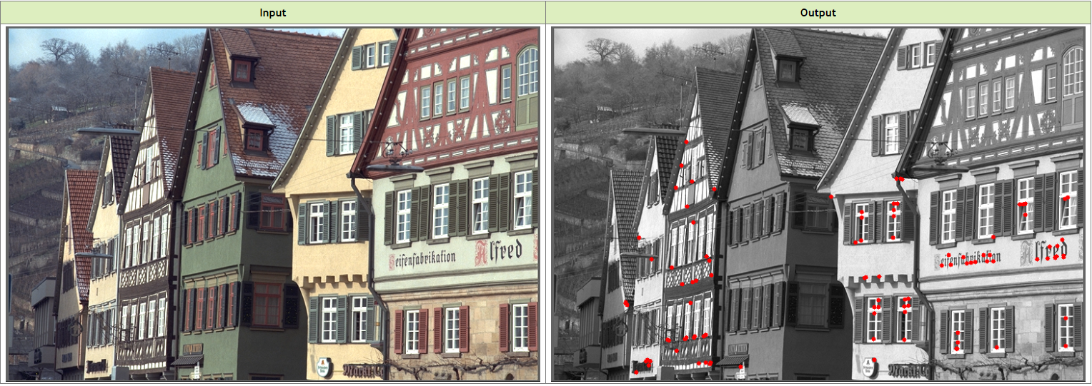
O.R.B. Corner Detection

Slide 37
O.R.B. Detection – Merits and Demerits
Merits
Demerits
Efficiency
Rotation Invariance
Scale Invariance
Binary Descriptors
Adaptive Pattern Selection
Subpixel Localization
Limited to Corners
Fixed Descriptor Length
Sensitivity to Noise
Limited Spatial Information
Limited Adaptability

Slide 38
Applications of Edge and Corner Detection
Image registration
Object detection
Object recognition
Object tracking
Image category recognition
Finding geometry of a stereo system
3-D reconstruction
Image retrieval
Motion detection
Video tracking
Image mosaicking
Panorama stitching

